Slide 1
Linux Commands And Permissions.
By :- Himanshu Singh

Slide 2
Linux Commands
whatis :-it tells us about another command in one line.
whatis ssh
whatis whatis
whatis ls
whatis whereis
whatis date
whatis cal
whatis w
whatis who
whatis pwd
whatis logout
Whatis --help

Slide 3
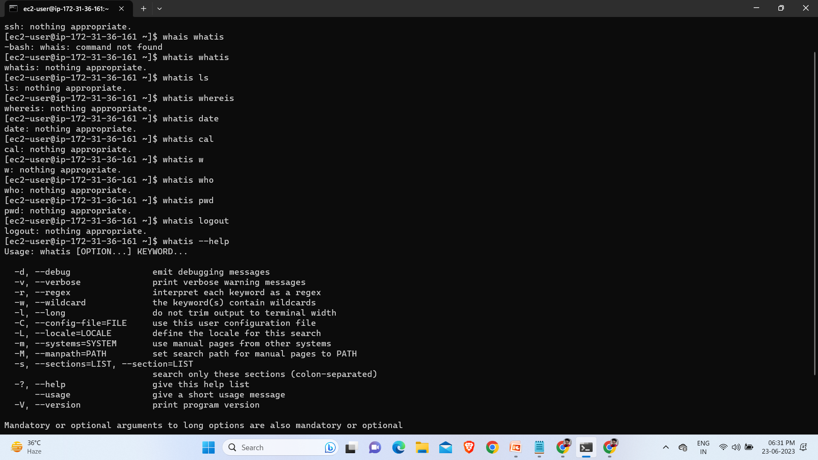

Slide 4
ls :- it lists the files present at current location.
whatis ls
which ls
whereis ls
date
whereis date
which date
cal
whatis cal
cal -1
cal -3
cal -j
cal -s
cal -m
cal -j 11 2023
cal -y
cal -Y
cal -w

Slide 5
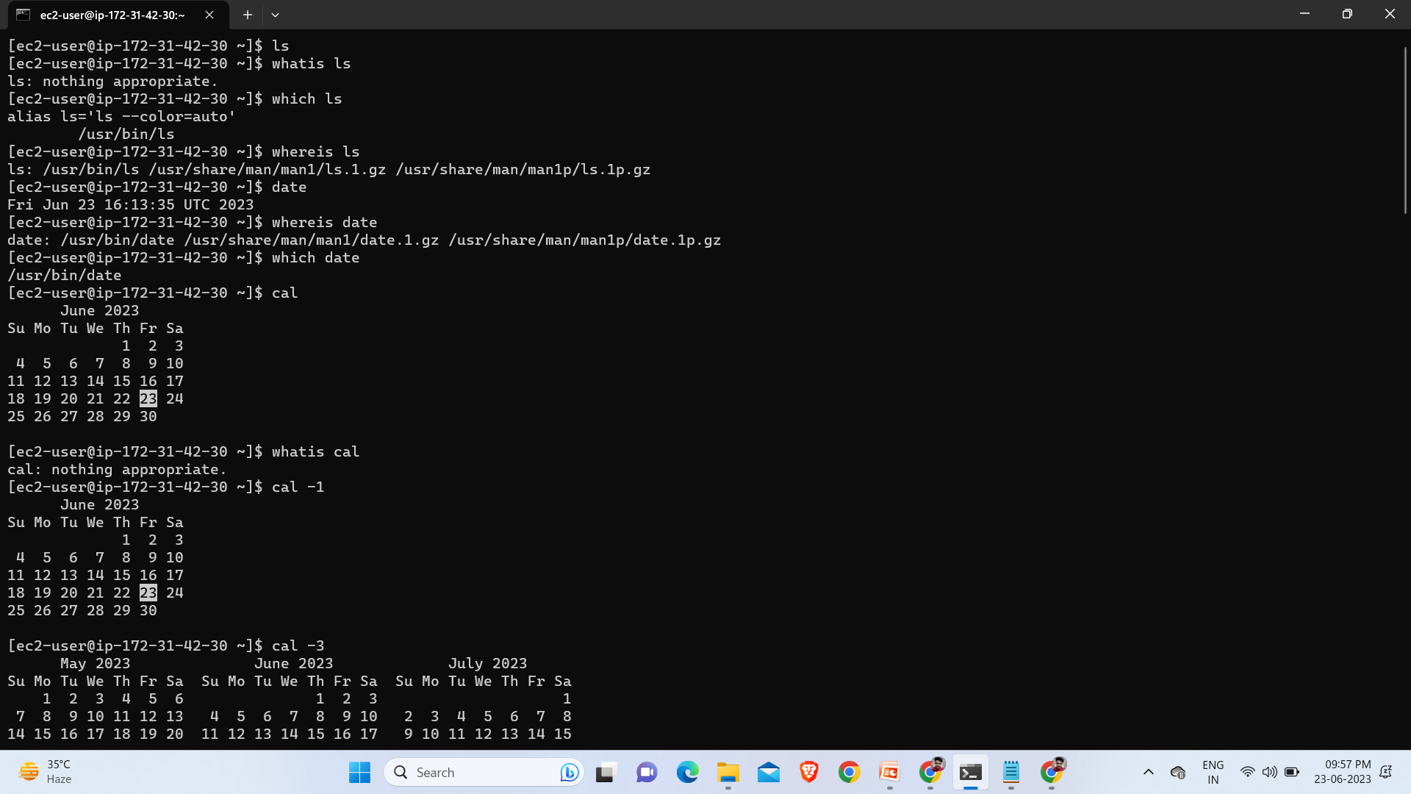

Slide 6
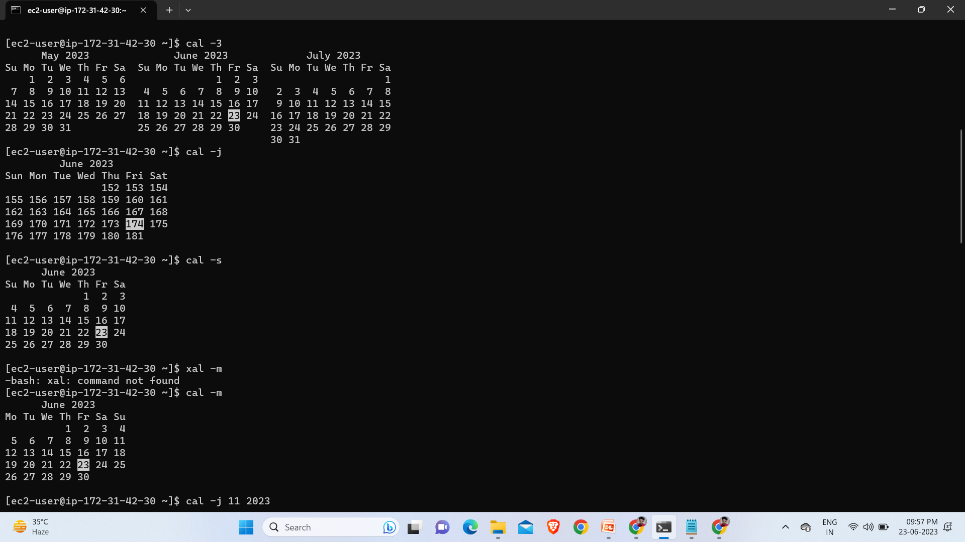

Slide 7
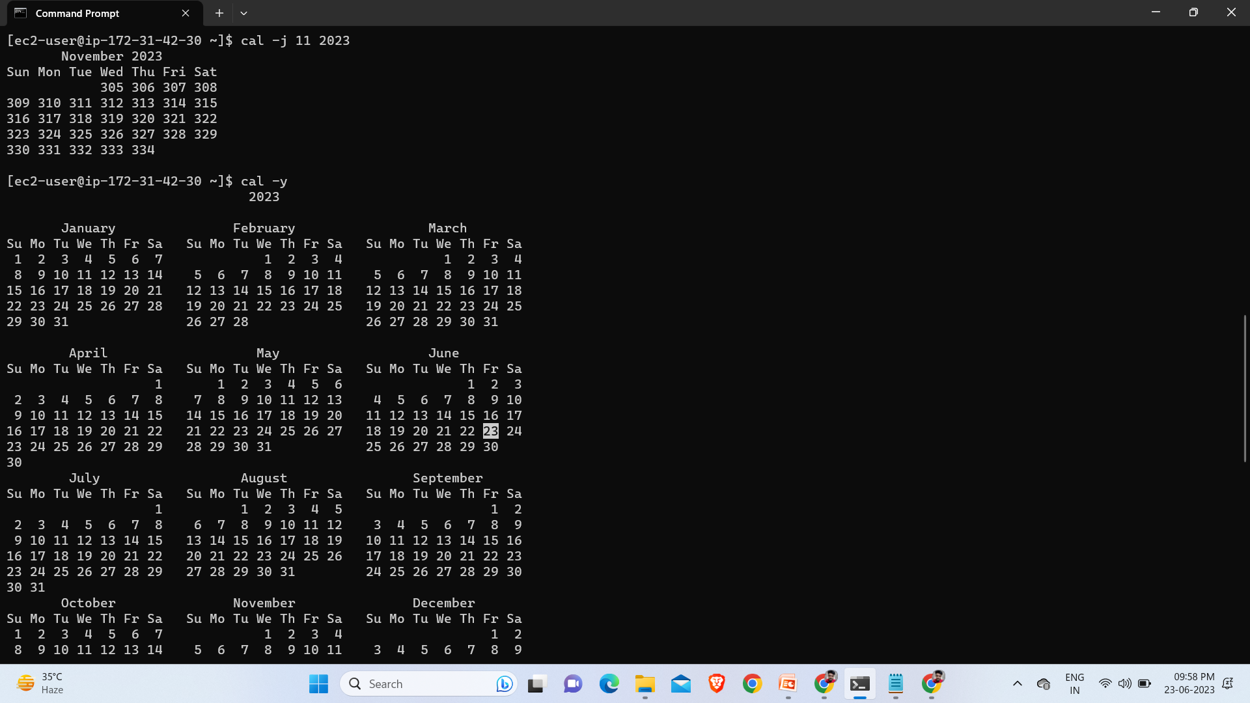

Slide 8
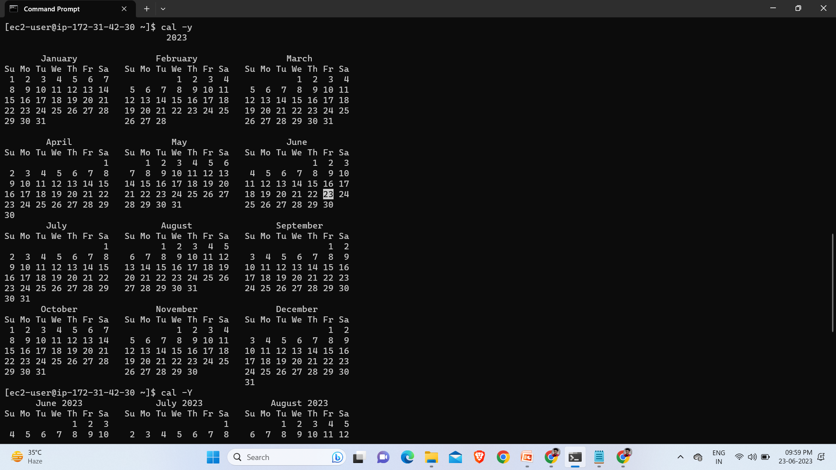

Slide 9
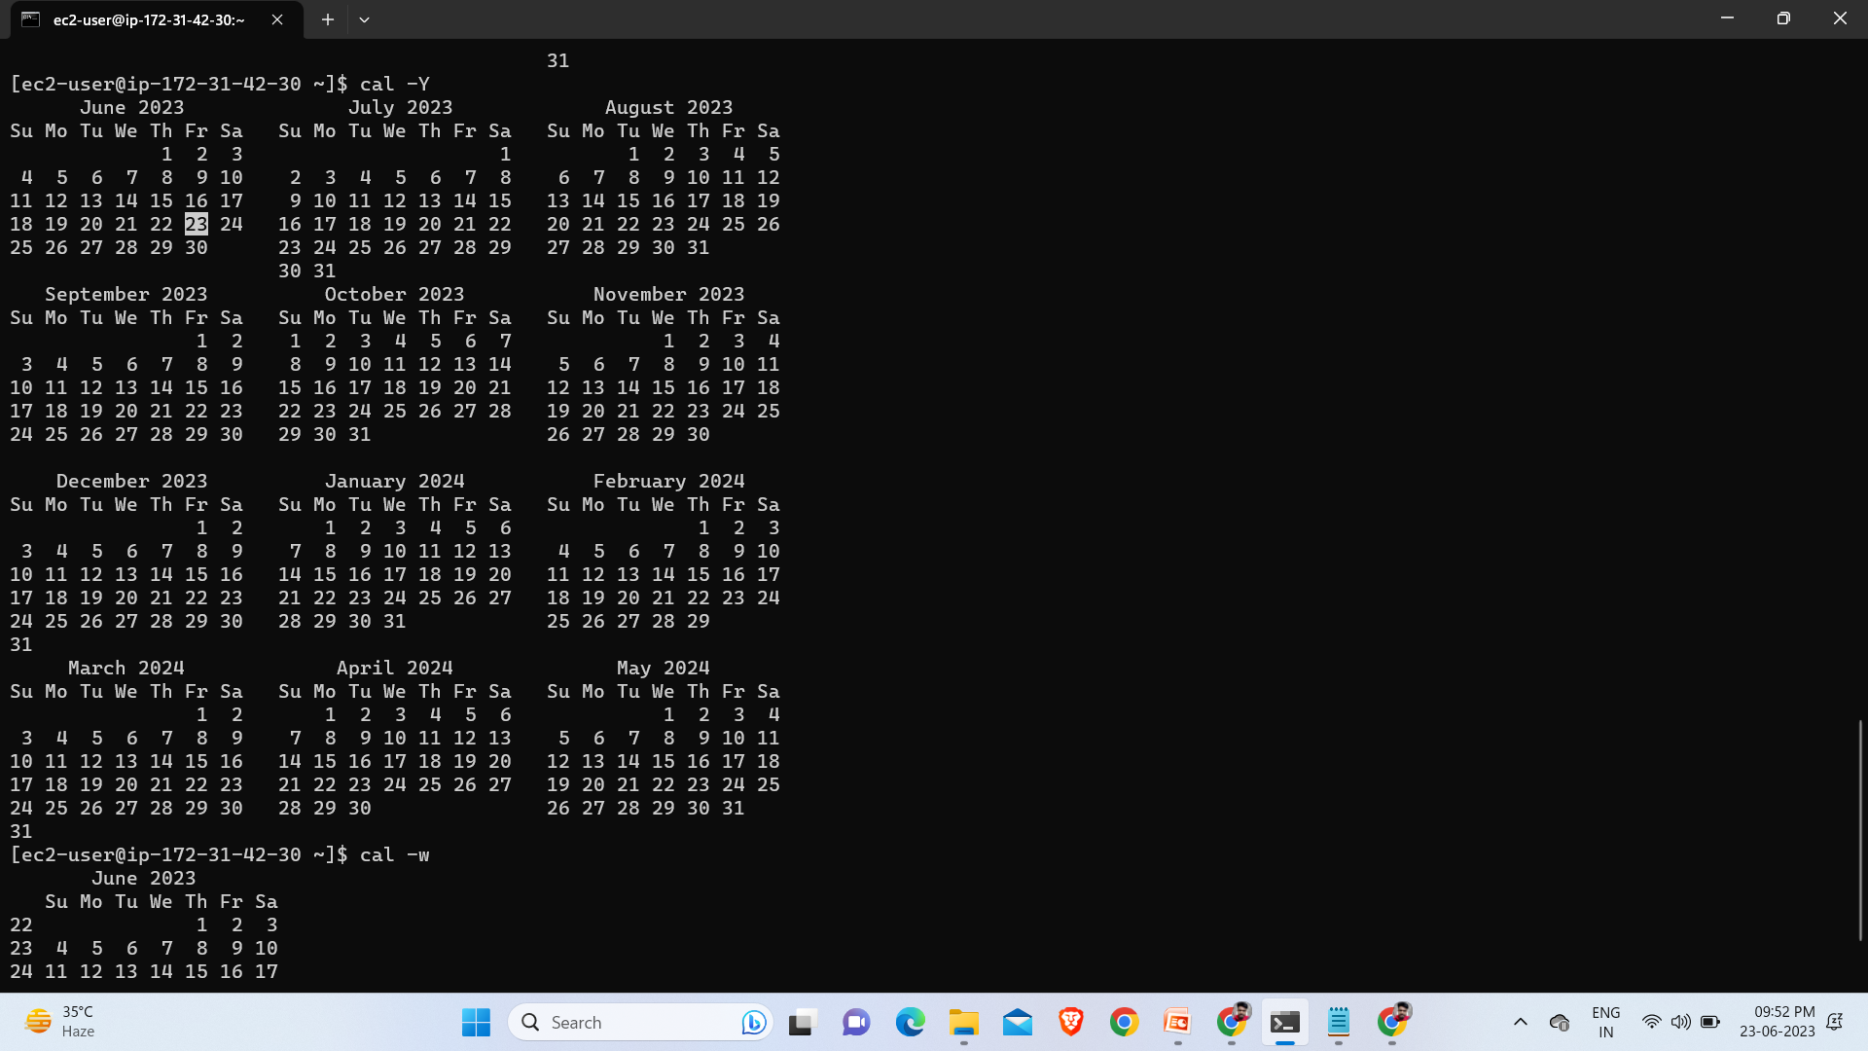

Slide 10
w :-Show who is logged on and what they are doing
who :-show who is logged on.
whatis w :-Show who is logged on and what they are doing.
whatis who :-show who is logged on.
history :-it tells us about our command(work) history.
pwd :-it will tell us about present working directory.
logout :-to logout from your current session.
exit :-to exit from current user/session.

Slide 11
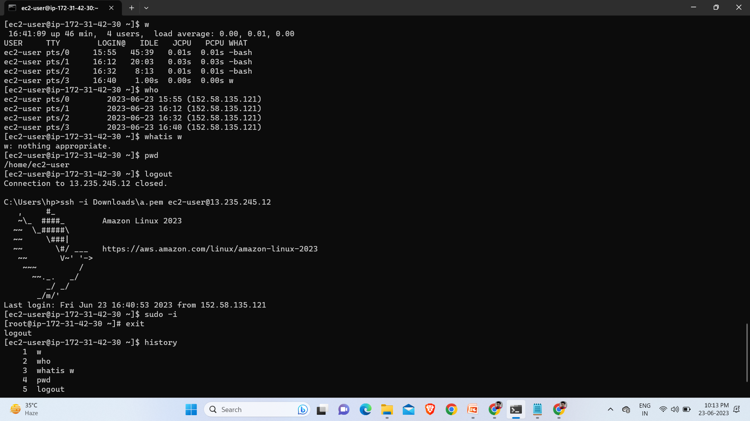

Slide 12
--help :-this is used to get the help information from any other command.
cal --help
ls --help
pwd --help
date --help
w --help
who --help
logout --help
whatis --help

Slide 13
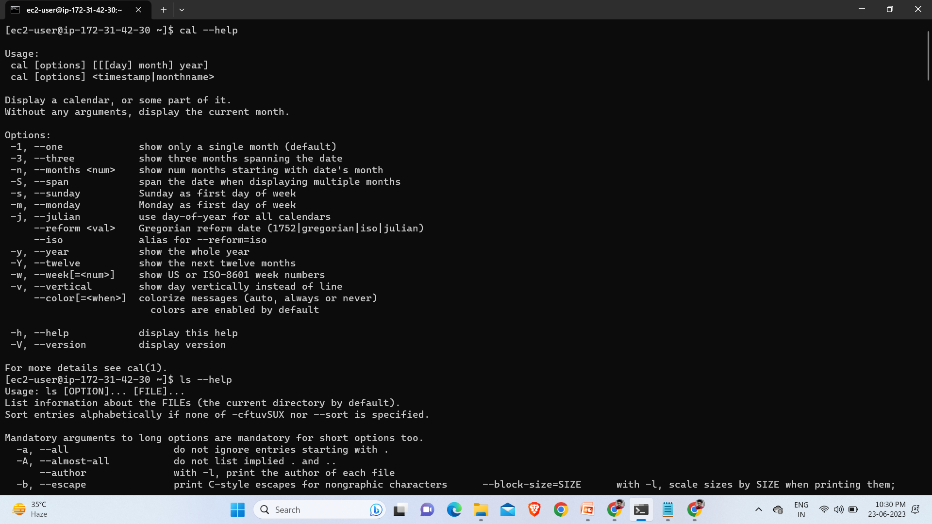

Slide 14
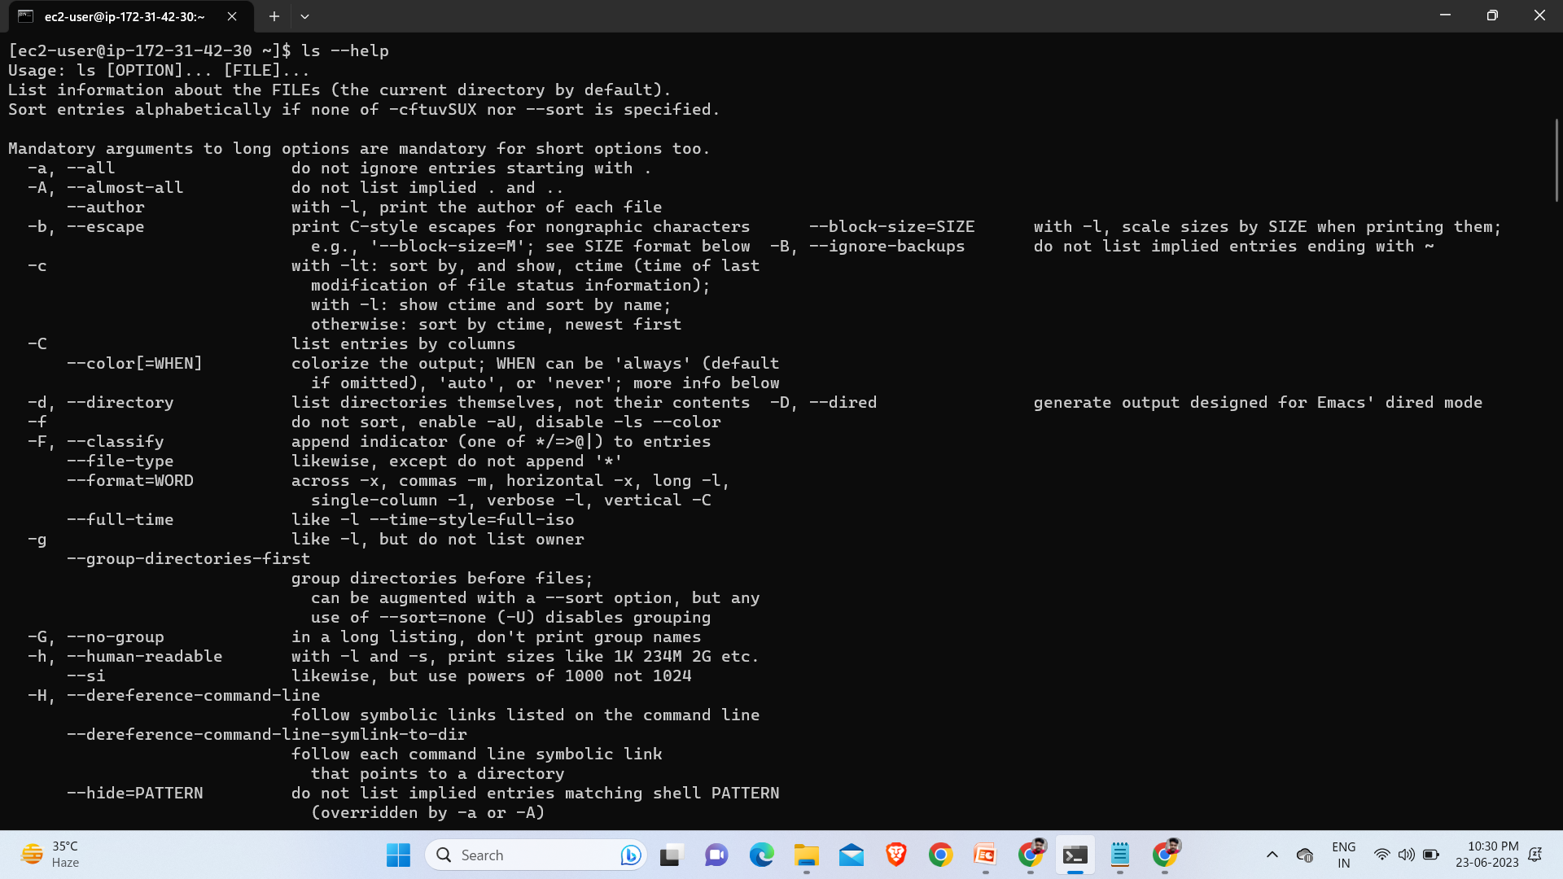

Slide 15
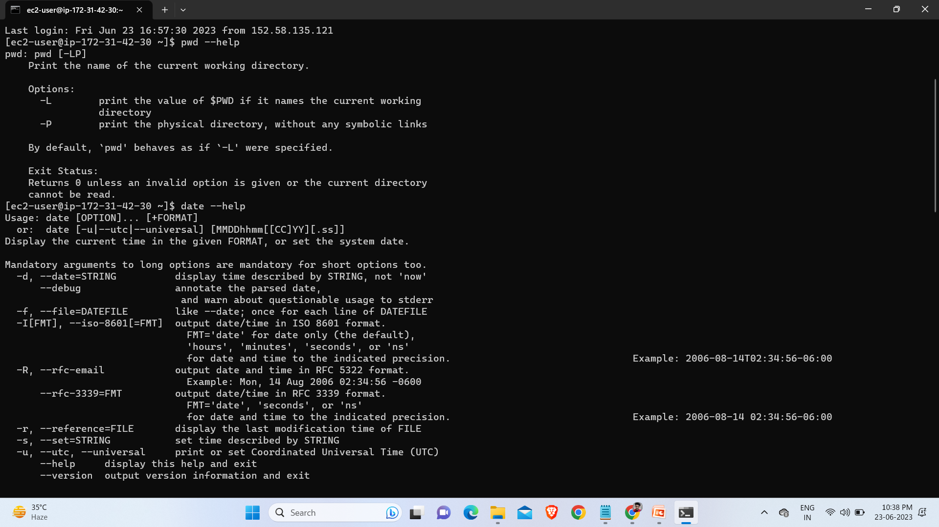

Slide 16
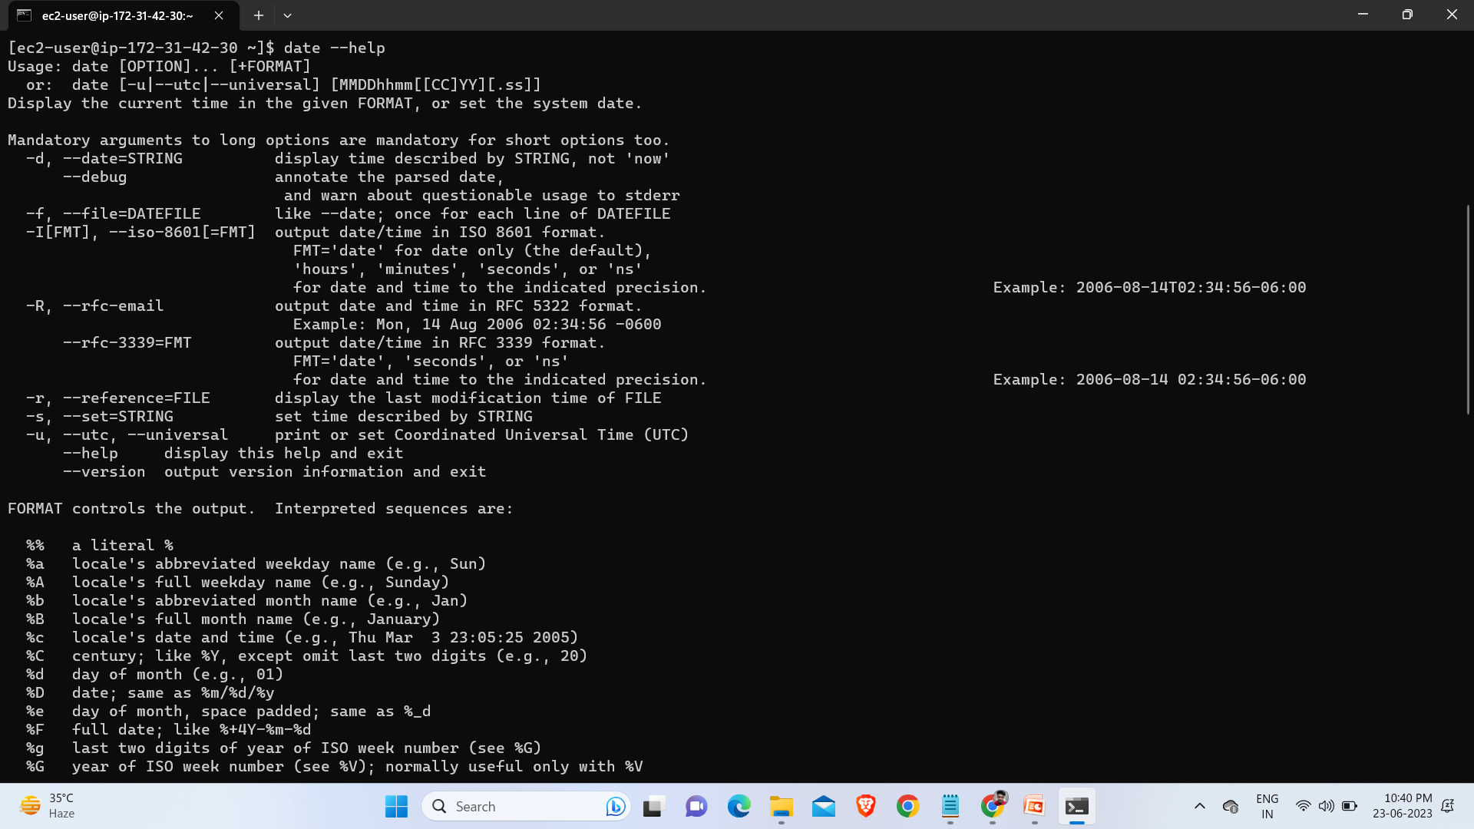

Slide 17
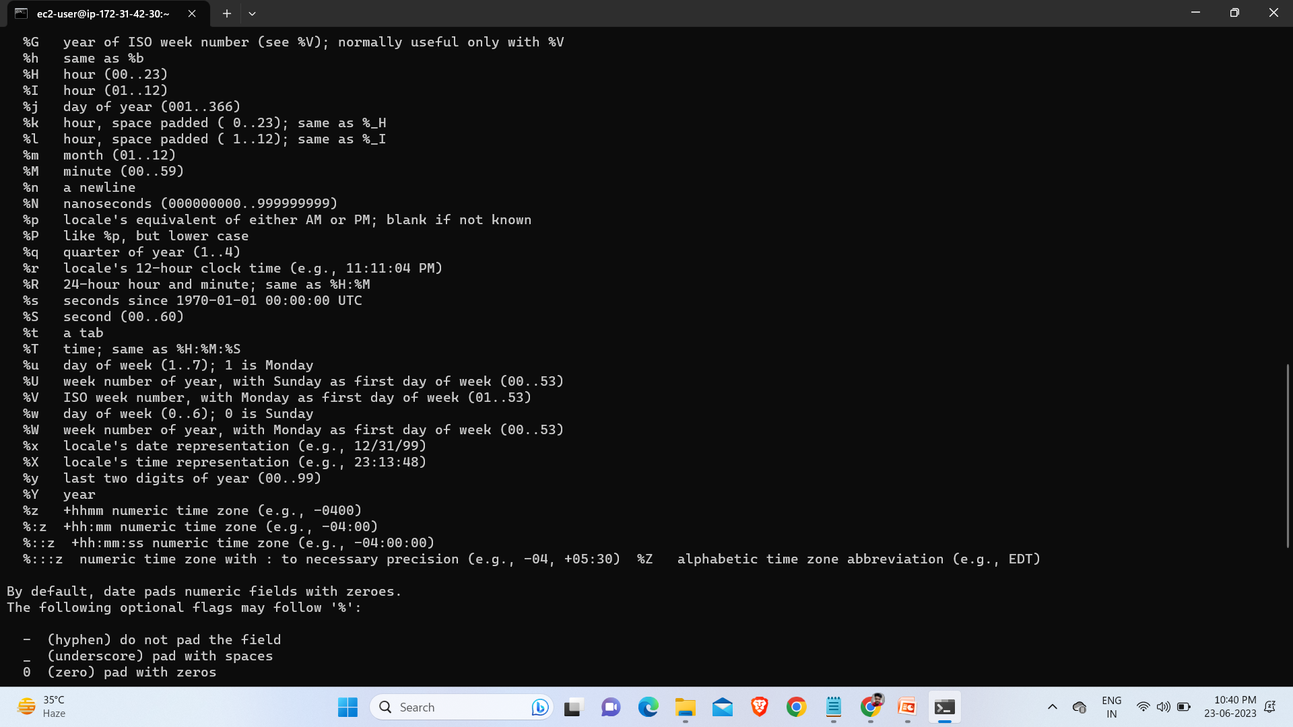

Slide 18
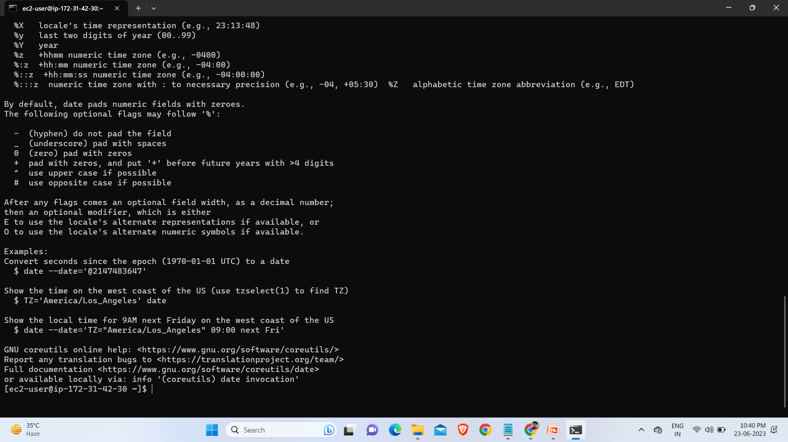

Slide 19
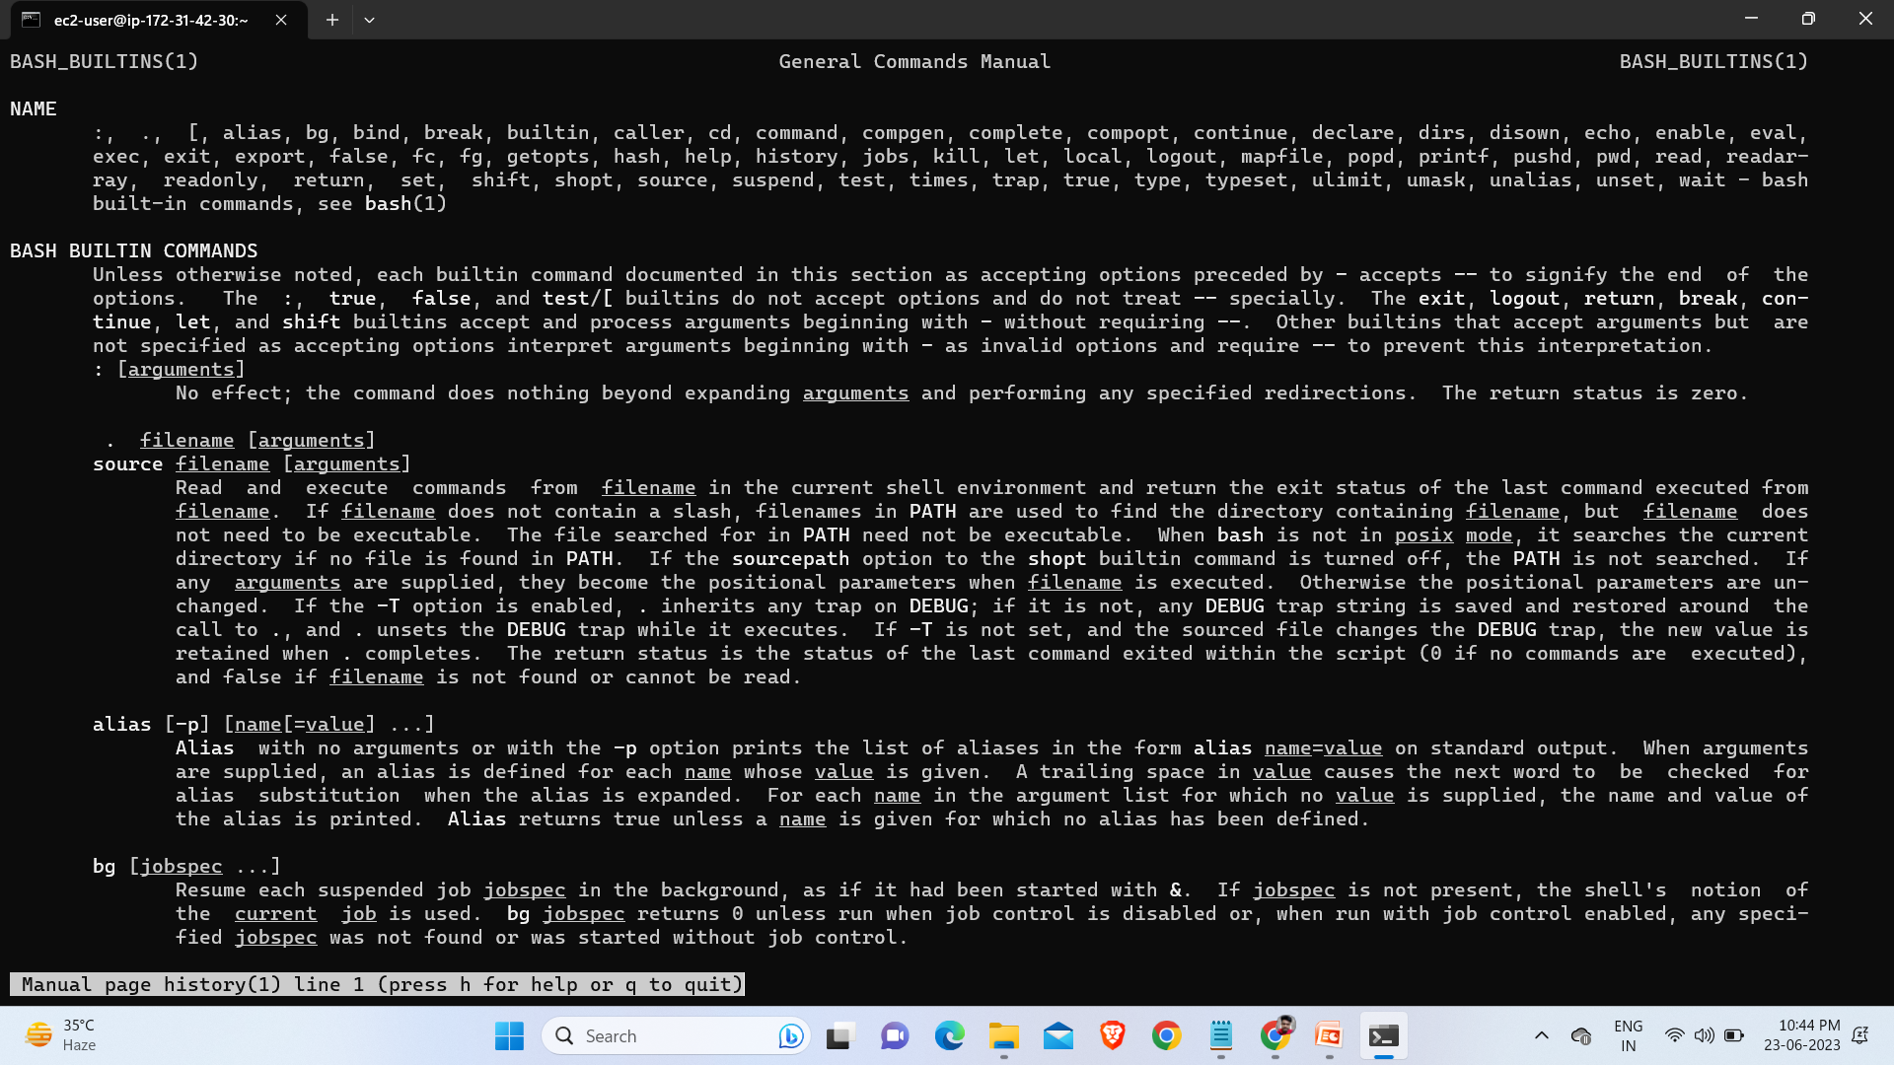
man history :- It is used page of history commands

Slide 20
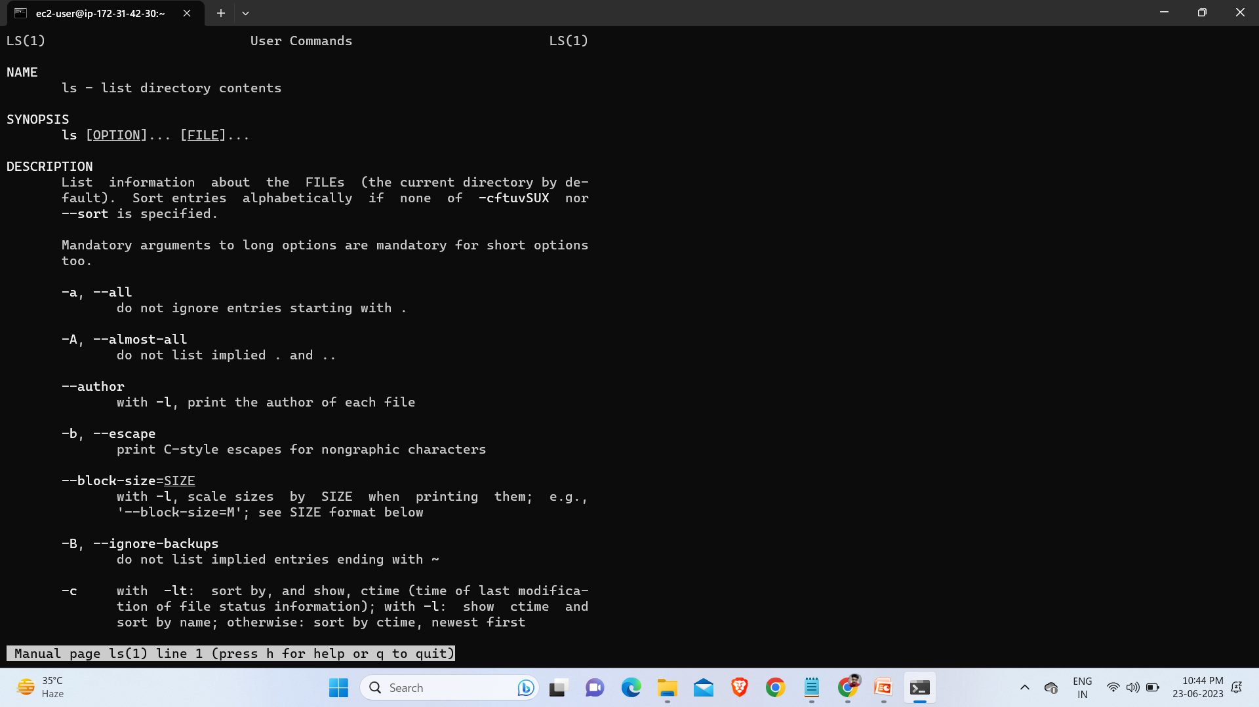
man ls :- it used to get mannual page of ls.

Slide 21
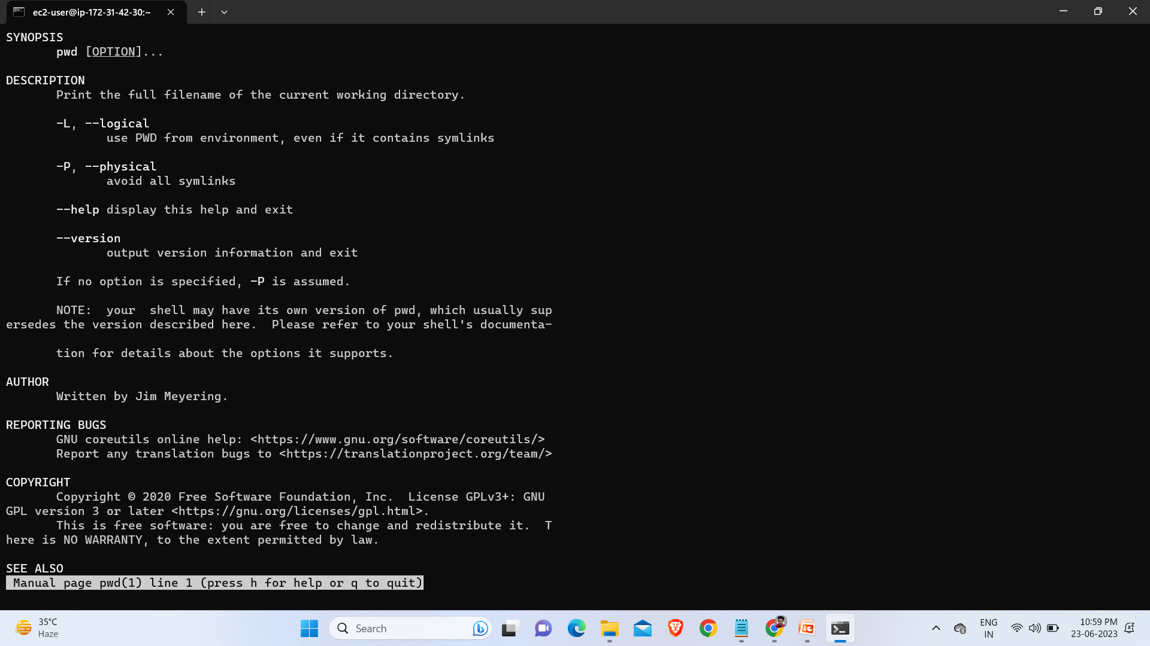
man pwd :- It is used to get manual page of pwd.

Slide 22
Info :-it will show me the information about "any other command“
info ls
info pwd
info cal
info date
info info

Slide 23
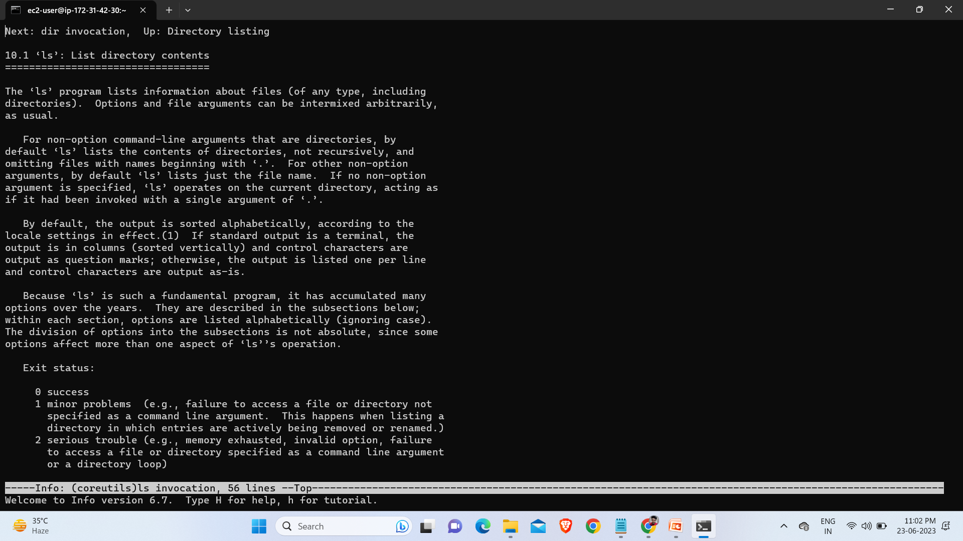
info ls :- To get information about ls.

Slide 24
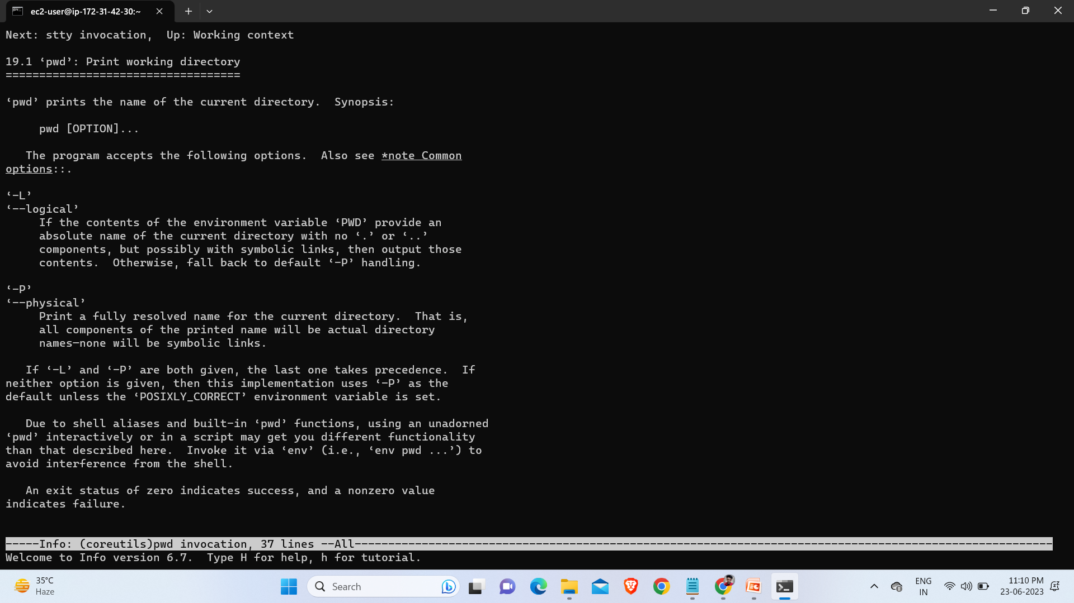
Info pwd :- to get information about pwd.

Slide 25
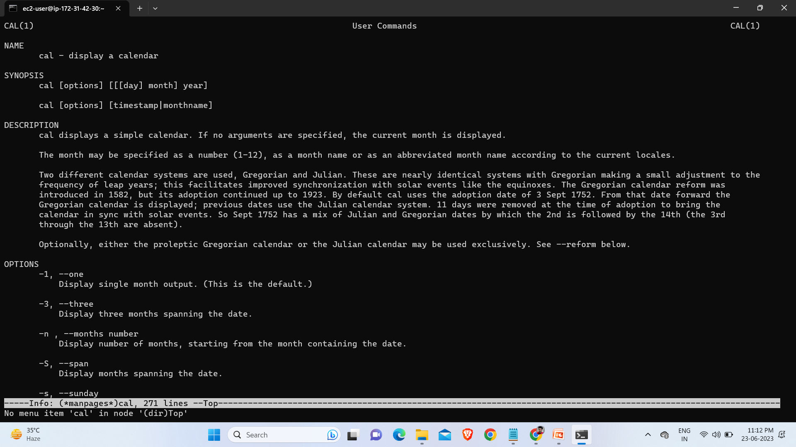
Info cal :- to get info of cal.

Slide 26
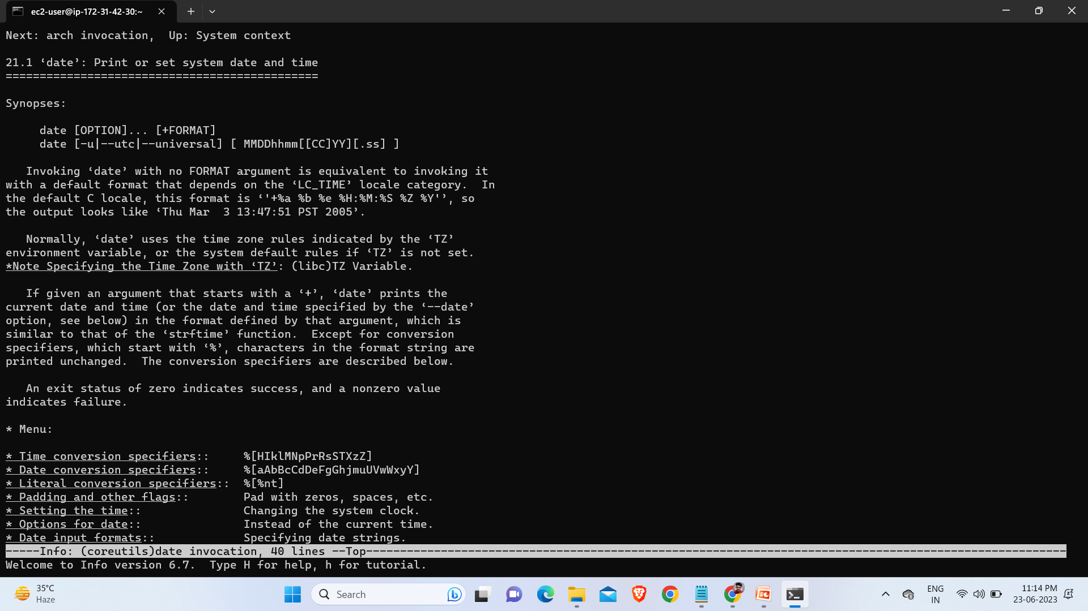
info date :- is used to get information of date.

Slide 27
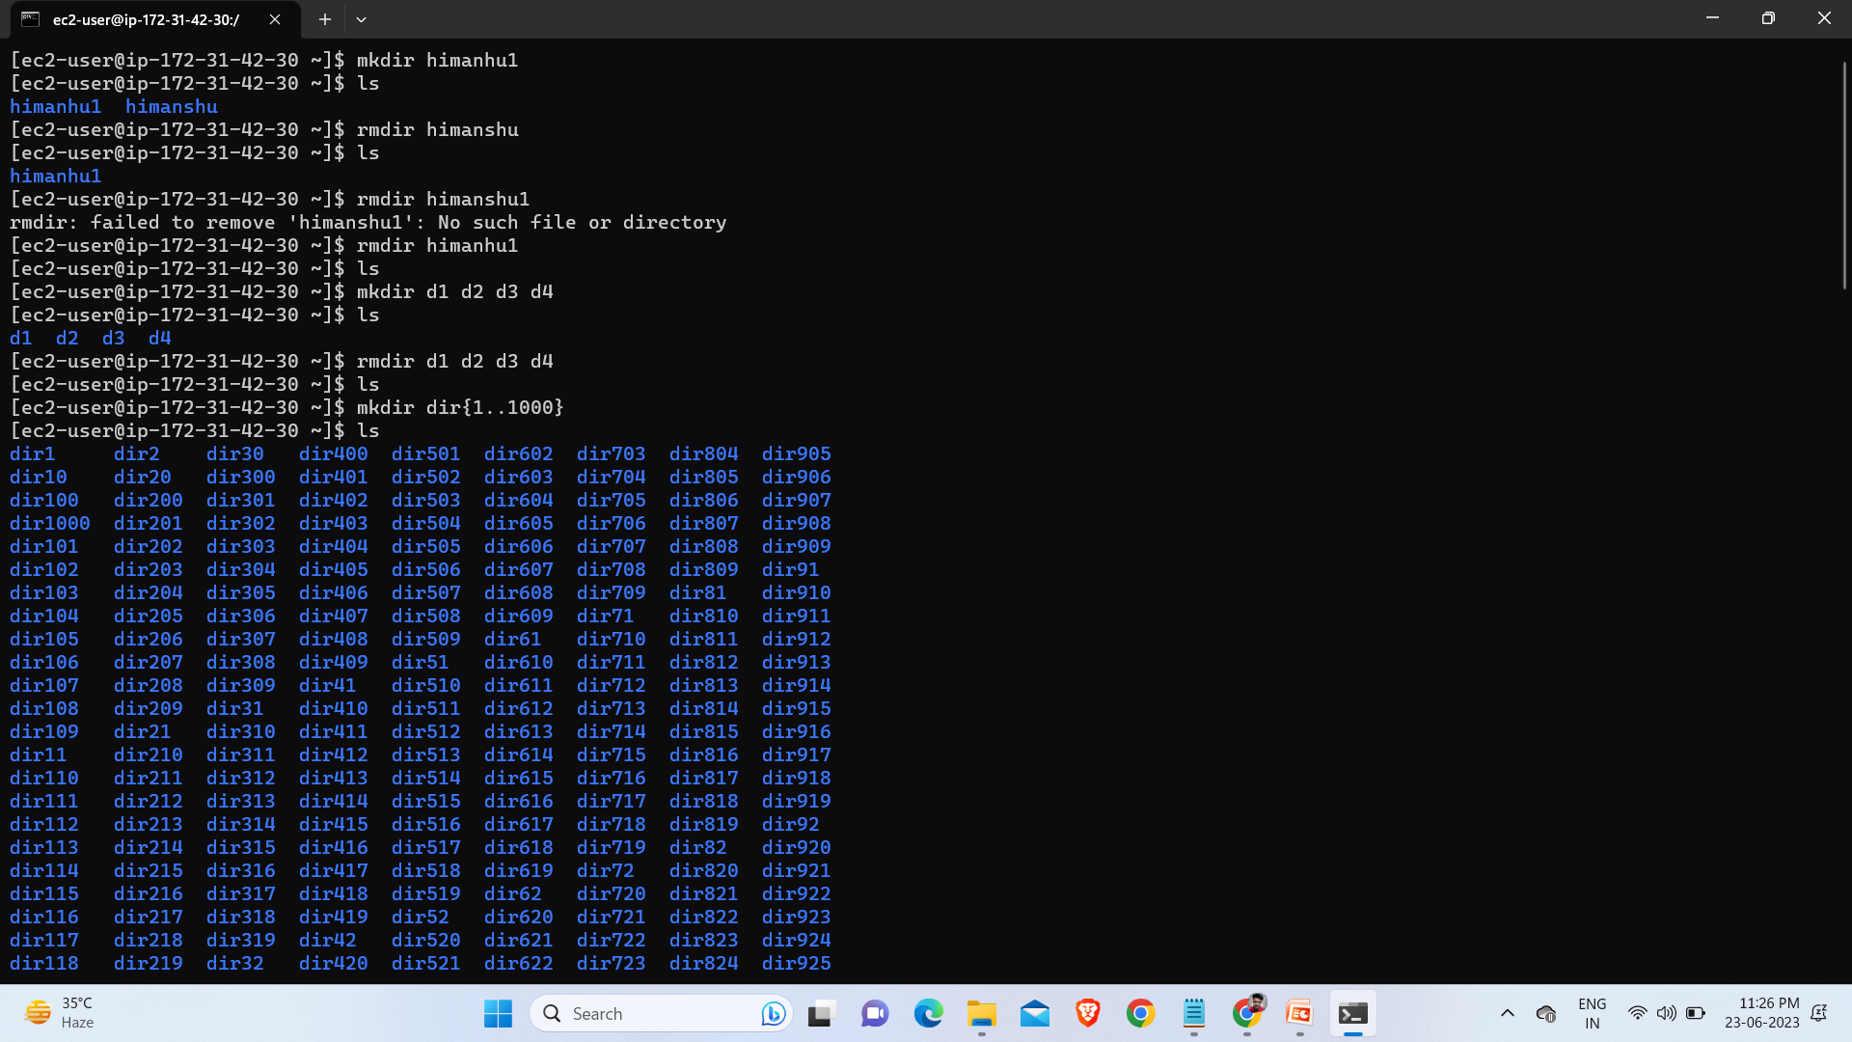
mkdir himanshu :-it create directory name himanshu.
rmdir himanshu :-it delete the directory name himanshu.
mkdir d1 d2 d3 d4 :- it will create multiple directory d1 d2 d3 d4.
rmdir d1 d2 d3 d4 :-
mkdir d{1..1000}:- it will create d1 to d1000 directory.

Slide 28
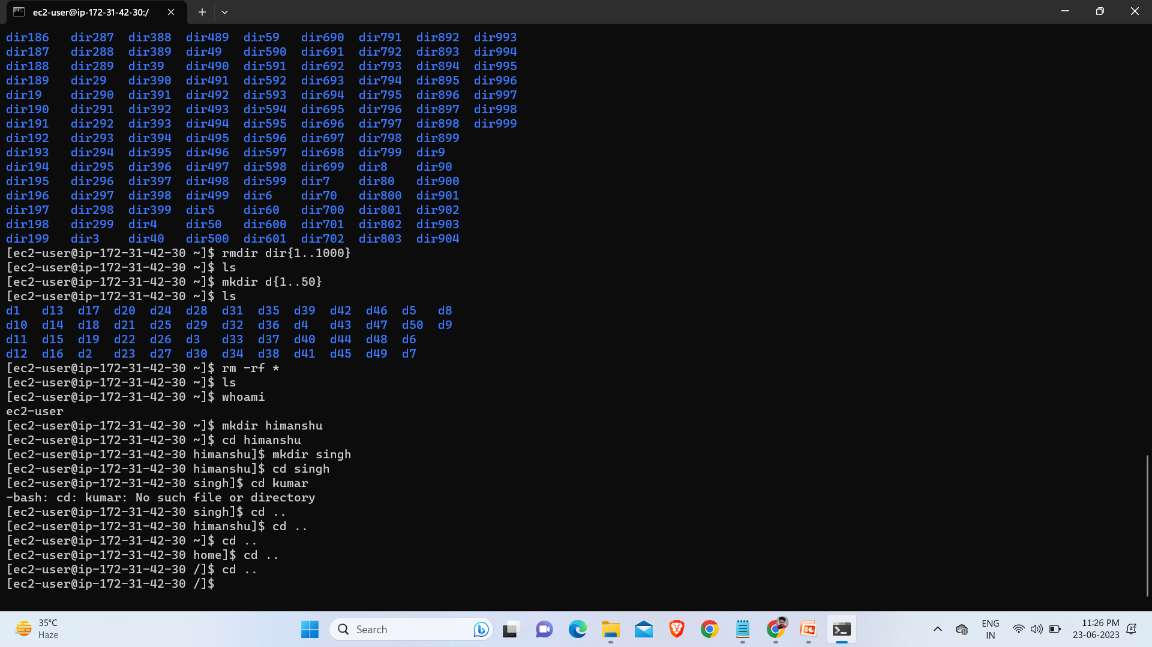
rm –rf * :- it is used to delete everthing.
cd himanshu :- is used to go inside himanshu directory.
cd .. :- is used to go outside from any directory.

Slide 29
Linux Permissions :- there are mostly 3 types of permissions in linux
read=r
write=w
execute=x
if first char. is d that means:-it is a directory.
if first char. is - that means:-it is a file.
Ex :- drwxr-xr-x
rwx:-these are the permissions for owner/user
r-x:-these are the permissions for group(group permissions)
r-x:-these are the permissions for others.
ls –l :- to check the permissions of file or directory.

Slide 30
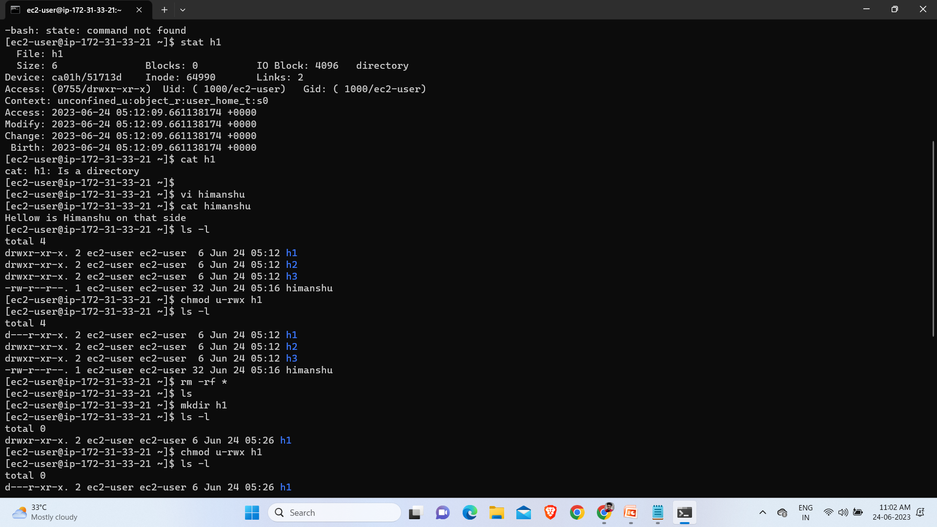
stat h1 :- used to check permissions assigned.
vi himanshu :- to create file named himanshu.
cat himanshu :- to see the content in side file.
ls –l :- is another commands to check permissions.
rm –rf * :- to delete all the files and directory.
owner/user = u
group = g
other = o

Slide 31
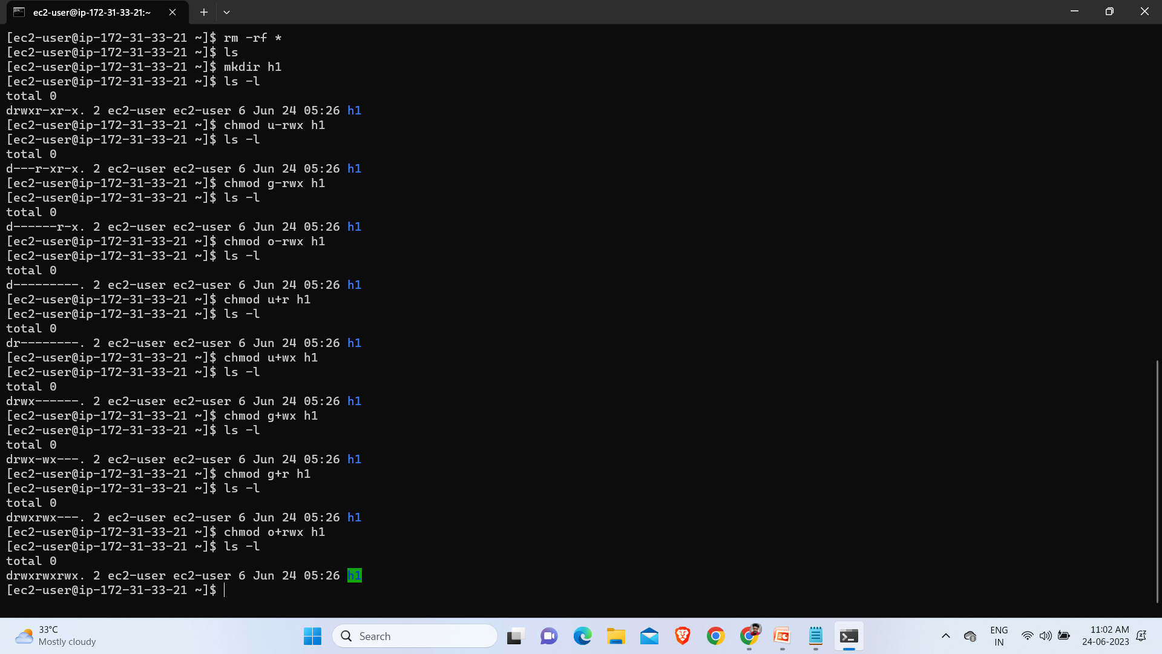
mkdir h1 :- to create directory h1.
ls -l :- to check the permissions.
drwxr-xr-x
chmod u-rwx h1 :- it will remove the permissons of user.
ls -l :- d---r-xr-x
chmod g-rwx :- it will remove the permissons of group.
ls -l :- d------r-x
chmod o-rwx :- it will remove the permissons of other.
ls -l :- d---------
chmod u+r h1 :- assign Read permission to user.
ls -l :- dr--------
chmod u+wx h1 :- assign Write & Execute permission to user.
ls -l :- drwx------.
chmod g+wx h1 :- assign Write & Execute permission to group.
ls -l :- drwx-wx---
chmod g+r h1 :- assign Read permission to group.
ls -l :- drwxrwx---.
chmod o+rwx h1 :- assign read , write & execute permission to other.
ls -l :- drwxrwxrwx.

Slide 32
Thank
You……

